Slide 1
Vindra Store Data Analysis

Slide 2
Agenda
Introduction
Sample Questions
Visual Store Data
Visual Store Data Report
Final Conclusions

Slide 3

Introduction
Vindra Store Wants to create an annual sales report for 2022.So that,Vindra can understand their customers and grow more sales in 2023.

Slide 4

Sample questions

Slide 5
Compare the sales and orders using single and orders using single charts.
Which month got the highest sales and orders?
Who purchased more between men or women in 2022?
What are the different order status in 2022?
List top 10 states contributing to the sales.
Relation between Age and Gender based on number of orders.
Which channel is contributing to maximum sales?
Highest selling category?

Slide 6
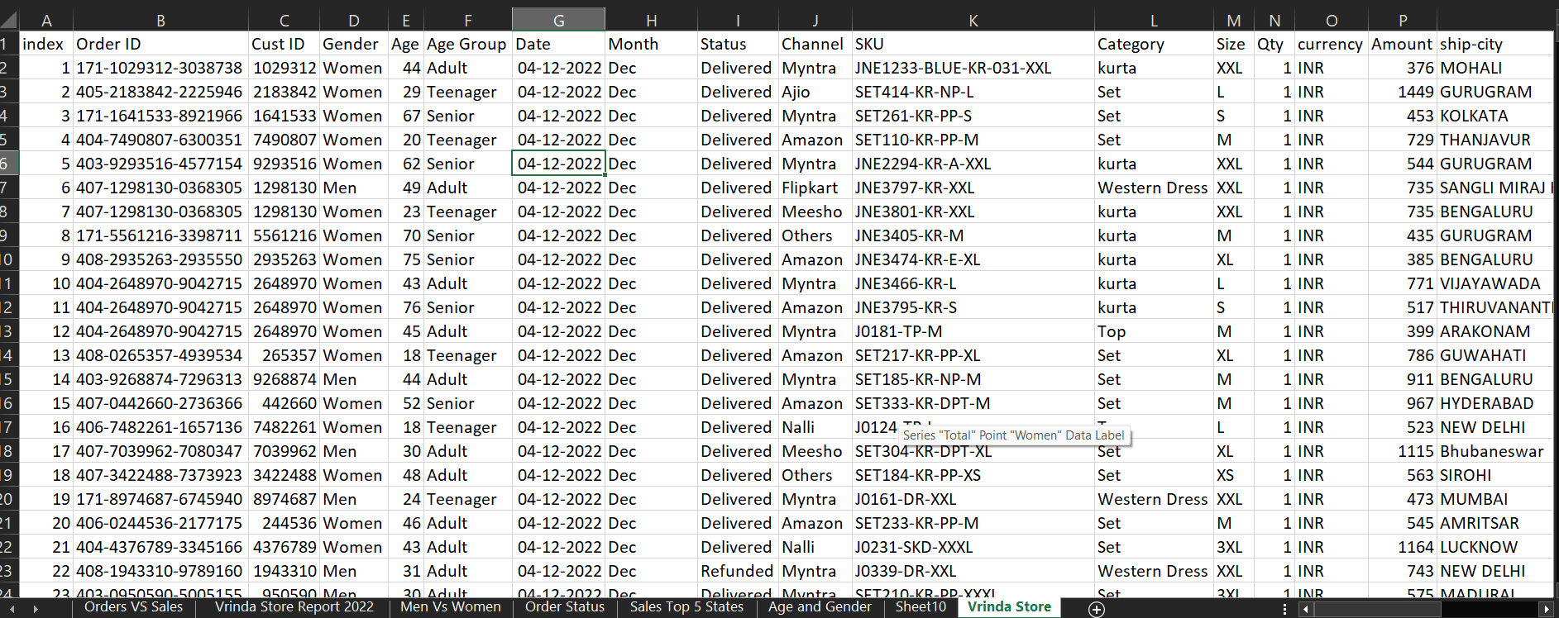
Vindra Store Data

Slide 7
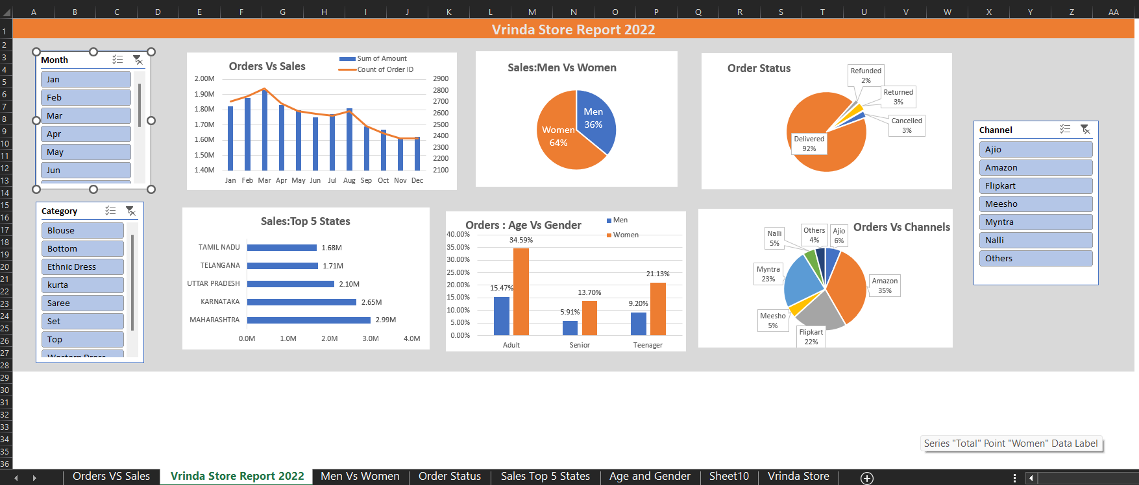
Vindra Store Report 2022

Slide 8
Sample Insights
Women are more likely to buy then men. (-65%)
Maharastra,Karnataka and Uttar Pradesh are the top 3 states.(-35%)
Adult age group (30-49 yrs) is maximum contributing (-50%)
Amazon,Flipkart and Myntra channels are max contributing (-80%)

Slide 9
Final Conclusion
Target Women customers af age group (30-49yrs) living in Maharastra,Karnataka and Uttar Pradesh by showing ads/offers/coupons available on Amazon,Flipkart and Myntra.

Slide 10
Thank you
Dibyabiva Chakra
9064449844
dibybiva.kchakra@gmail.com

